Slide 1


Hiring Process Analytics
Manan Yadav

Slide 2

Table of Contents!
Project Description
Tech – Stack Used
Approach
Insights
A short overview of the project
Tools used to do the project
How I went through solving the project and derive useful insights
What I learned solving the project

Slide 3
Table of Contents!
Solutions
Results
Solutions of the questions asked in the project
Final outcome of the project

Slide 4
Project Description
In this project, a certain dataset is given which contains various records of the employees that were hired or not hired and other details about the employees which were collected during the hiring process done by the company. For every company, the hiring process is one of the most important processes, and as a number of employees apply for the job to get hired so that creates a huge amount of data, which can be used to get useful insights.
As a data analyst my job is to study the data and pull out various insights which can be very useful for the company in the future. Insights like the number of employees hired, the average salary offered by the company, and the number of employees working in different departments, etc.
To solve this project I need to first study the dataset thoroughly and understand the different columns given, then use various formulas in excel to get the needed insights. To get certain insights I need to use multiple formulas or a combination of multiple formulas.

Slide 5



Approach
The approach was to study the given dataset so I know how the dataset is made and then use various formulas to get the needed insights from the data.

Slide 6
Tech–Stack Used:
Microsoft Excel
Microsoft PowerPoint

Slide 7
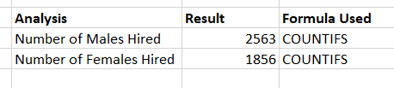

Solutions
A. Number of Males and Females hired:
B. Average Salary Offered in the Company

Slide 8
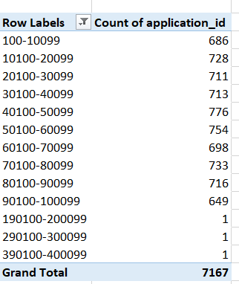
C. Class intervals for the salary

Slide 9
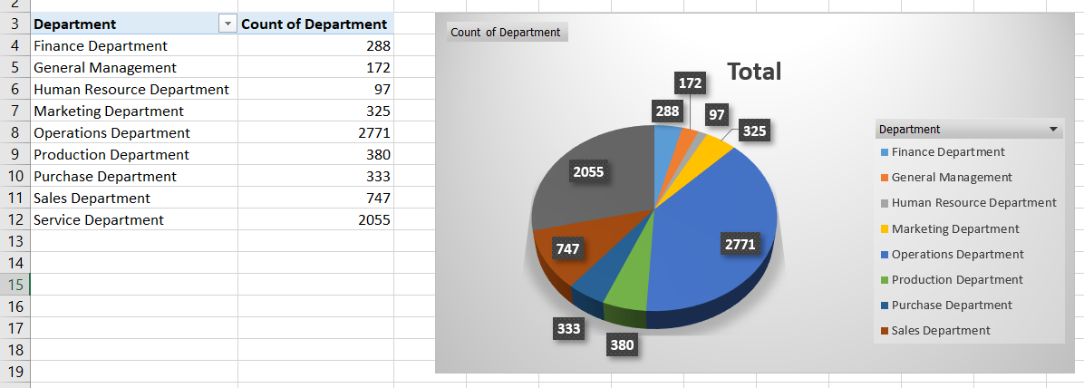
D. Proportion of People working in different Departments

Slide 10
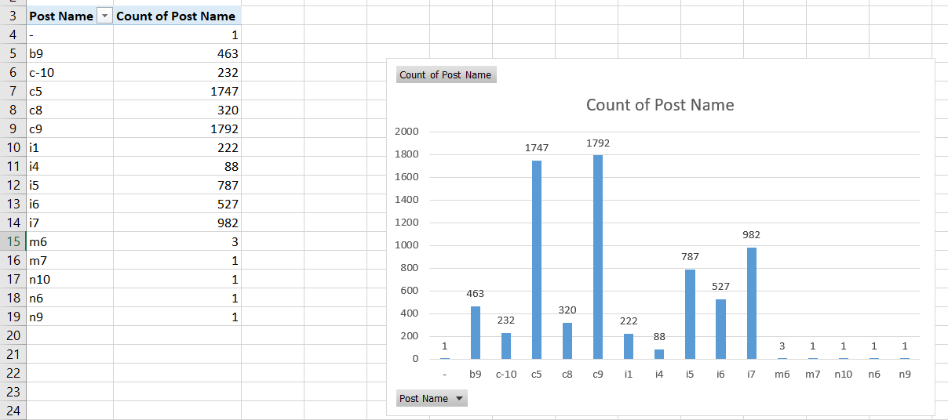
E. Different Post Tiers

Slide 11
Insights
In this project, we understand the importance of data manipulation from the given data set. From a single data set we can get any number of insights that we want which will help the various teams to take important decisions.
Excel being a very easy to use tool because of its wide range of functions makes the process of data cleaning, visualizing, manipulating very convenient so we can get various useful insights from the data set.
As a data analyst pulling out useful information from bulky datasets is very importance and especially the hiring process analysis through which the company can make decisions for future hiring process.

Slide 12

Through this project I got to learn how we can use a powerful tool like excel on a dataset to get useful insights. The many functions in excel make it easier for us to manipulate data from the data set and get various insights which can also be used for data visualization. The visualization of the data helped us to get a deeper understanding and more appealing way to present the insights.
Book Title. P52
Results

